Slide 1
Unit 4
Memory System
By:
Dr. Gourav Verma,
ECE Dept.
GEU

Slide 2
Unit 4 Contents
Memory System: Basic Concepts, Types of Memory, Speed, Size, and Cost, The Memory Hierarchy, Locality of Reference, Cache Memories – Mapping Functions, Replacement Algorithms, Effective Access Time and Hit Ratio, Virtual Memory-Paging, Advantages and Disadvantages of Paging and Virtual Memory, Segmentation, Paging Combined with Segmentation, Real World Example of Memory Management-Pentium 4 Memory Management

Slide 3
Some basic concepts
Maximum size of the Main Memory
byte-addressable
CPU-Main Memory Connection
Processor
k
-bit
Memory
address bus
MAR
n
-bit
data bus
Up to 2
k
addressable
MDR
locations
Word length =
n
bits
Control lines
R
/
W
( , MFC, etc.)

Slide 4
Some basic concepts(Contd.,)
Measures for the speed of a memory:
memory access time.
memory cycle time.
An important design issue is to provide a computer system with as large and fast a memory as possible, within a given cost target.
Several techniques to increase the effective size and speed of the memory:
Cache memory (to increase the effective speed).
Virtual memory (to increase the effective size).

Slide 5
Internal organization of memory chips
Each memory cell can hold one bit of information.
Memory cells are organized in the form of an array.
One row is one memory word.
All cells of a row are connected to a common line, known as the “word line”.
Word line is connected to the address decoder.
Sense/write circuits are connected to the data input/output lines of the memory chip.

Slide 6
Internal organization of memory chips (Contd.,)
7
7
1
1
0
0
W
0
•
•
•
FF
FF
A
0
W
1
•
•
•
A
1
Address
Memory
decoder
•
•
•
•
•
•
•
•
•
•
•
•
•
•
•
•
•
•
cells
A
2
A
3
W
15
•
•
•
Sense / Write
Sense / Write
Sense / Write
R
/
W
circuit
circuit
circuit
CS
Data input
/output lines:
b
7
b
1
b
0

Slide 7
SRAM Cell
Two transistor inverters are cross connected to implement a basic flip-flop.
The cell is connected to one word line and two bits lines by transistors T1 and T2
When word line is at ground level, the transistors are turned off and the latch retains its state
Read operation: In order to read state of SRAM cell, the word line is activated to close switches T1 and T2. Sense/Write circuits at the bottom monitor the state of b and b’
b
b
′
T
1
X
Y
T
2
Word line
Bit lines

Slide 8
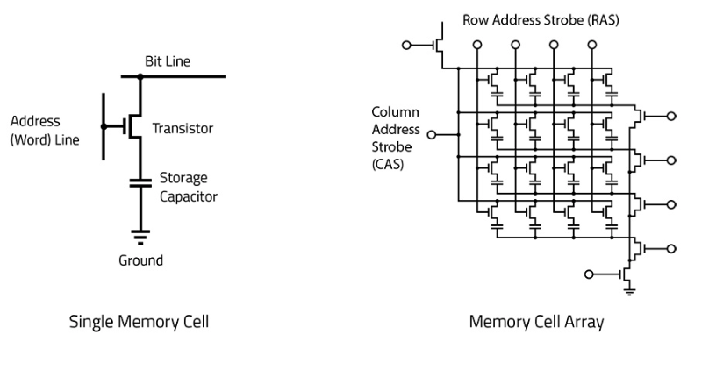
DRAM Cell

Slide 9
Asynchronous DRAMs
Static RAMs (SRAMs):
Consist of circuits that are capable of retaining their state as long as the power is applied.
Volatile memories, because their contents are lost when power is interrupted.
Access times of static RAMs are in the range of few nanoseconds.
However, the cost is usually high.
Dynamic RAMs (DRAMs):
Do not retain their state indefinitely.
Contents must be periodically refreshed.
Contents may be refreshed while accessing them for reading.

Slide 10
Latency, Bandwidth
Memory latency is the time it takes to transfer a word of data to or from memory
Memory bandwidth is the number of bits or bytes that can be transferred in one second.

Slide 11
Memory controller
Recall that in a dynamic memory chip, to reduce the number of pins, multiplexed addresses are used.
Address is divided into two parts:
High-order address bits select a row in the array.
They are provided first, and latched using RAS signal.
Low-order address bits select a column in the row.
They are provided later, and latched using CAS signal.
However, a processor issues all address bits at the same time.
In order to achieve the multiplexing, memory
controller circuit is inserted between the processor
and memory.

Slide 12
Memory controller (contd..)
Row/Column
Address
address
R
A
S
R
/
W
Memory
C
A
S
Request
controller
R
/
W
Processor
Memory
C
S
Clock
Clock
Data

Slide 13
Read-Only Memories (ROMs)
SRAM and SDRAM chips are volatile:
Lose the contents when the power is turned off.
Many applications need memory devices to retain contents after the power is turned off.
For example, computer is turned on, the operating system must be loaded from the disk into the memory.
Store instructions which would load the OS from the disk.
Need to store these instructions so that they will not be lost after the power is turned off.
We need to store the instructions into a non-volatile memory.
Non-volatile memory is read in the same manner as volatile memory.
Separate writing process is needed to place information in this memory.
Normal operation involves only reading of data, this type
of memory is called Read-Only memory (ROM).

Slide 14
Read-Only Memories (Contd.,)
Read-Only Memory:
Data are written into a ROM when it is manufactured.
Programmable Read-Only Memory (PROM):
Allow the data to be loaded by a user.
Process of inserting the data is irreversible.
Storing information specific to a user in a ROM is expensive.
Providing programming capability to a user may be better.
Erasable Programmable Read-Only Memory (EPROM):
Stored data to be erased and new data to be loaded.
Flexibility, useful during the development phase of digital systems.
Erasable, reprogrammable ROM.
Erasure requires exposing the ROM to UV light.

Slide 15
Read-Only Memories (Contd.,)
Electrically Erasable Programmable Read-Only Memory (EEPROM):
To erase the contents of EPROMs, they have to be exposed to ultraviolet light.
Physically removed from the circuit.
EEPROMs the contents can be stored and erased electrically.
Flash memory:
Has similar approach to EEPROM.
Read the contents of a single cell, but write the contents of an entire block of cells.
Flash devices have greater density.
Higher capacity and low storage cost per bit.
Power consumption of flash memory is very low, making it attractive for use in equipment that is battery-driven.
Single flash chips are not sufficiently large, so
larger memory modules are implemented using
flash cards and flash drives.

Slide 16
Speed, Size, and Cost
A big challenge in the design of a computer system is to provide a sufficiently large memory, with a reasonable speed at an affordable cost.
Static RAM:
Very fast, but expensive, because a basic SRAM cell has a complex circuit making it impossible to pack a large number of cells onto a single chip.
Dynamic RAM:
Simpler basic cell circuit, hence are much less expensive, but significantly slower than SRAMs.
Magnetic disks:
Storage provided by DRAMs is higher than SRAMs, but is still less than what is necessary.
Secondary storage such as magnetic disks provide a large amount
of storage, but is much slower than DRAMs.

Slide 17
Memory Hierarchy
Pr
ocessor
Fastest access is to the data held in
processor registers. Registers are at
the top of the memory hierarchy.
Relatively small amount of memory that
can be implemented on the processor
chip. This is processor cache.
Two levels of cache. Level 1 (L1) cache
is on the processor chip. Level 2 (L2)
cache is in between main memory and
processor.
Next level is main memory, implemented
as SIMMs. Much larger, but much slower
than cache memory.
Next level is magnetic disks. Huge amount
of inexepensive storage.
Speed of memory access is critical, the
idea is to bring instructions and data
that will be used in the near future as
close to the processor as possible.
Re
gisters
Increasing
Increasing
Increasing
size
speed
cost per bit
Primary
L1
cache
Secondary
L2
cache
Main
memory
Magnetic disk
secondary
memory

Slide 18
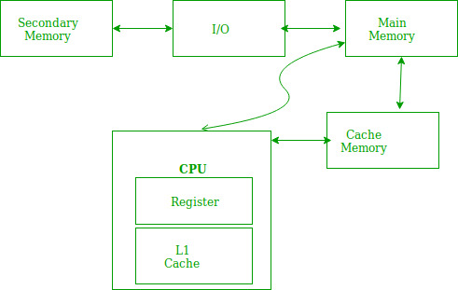
Locality of Reference
Locality of reference refers to a phenomenon in which a computer program tends to access same set of memory locations for a particular time period. In other words, Locality of Reference refers to the tendency of the computer program to access instructions whose addresses are near one another. The property of locality of reference is mainly shown by loops and subroutine calls in a program.

Slide 19
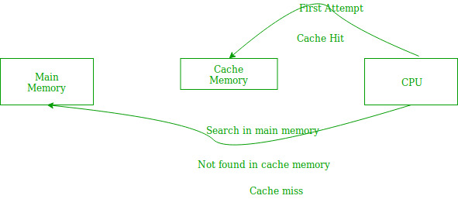
In case of loops in program control processing unit repeatedly refers to the set of instructions that constitute the loop.
In case of subroutine calls, everytime the set of instructions are fetched from memory.
References to data items also get localized that means same data item is referenced again and again.
the main memory will be searched for the required data or instruction that was being searched and if found will go through one of the two ways:
First way is that the CPU should fetch the required data or instruction and use it and that’s it but what, when the same data or instruction is required again. CPU again has to access the same main memory location for it and we already know that main memory is the slowest to access.
The second way is to store the data or instruction in the cache memory so that if it is needed soon again in the near future it could be fetched in a much faster way.

Slide 20
Locality has three properties
Temporal Locality(e.g. Loop)
Spatial Locality(e.g. Algorithm)
Sequential Locality(e.g. array)

Slide 21
Cache Mapping and its types
Direct mapping
Fully associate
K-way set associate
HDD
CPU
Main
Memory
L1 Cache
Block
Line

Slide 22
Cache memories
Processor
Cache
Main
memory
Processor issues a Read request, a block of words is transferred from the main memory to the cache, one word at a time.
Subsequent references to the data in this block of words are found in the cache.
At any given time, only some blocks in the main memory are held in the cache. Which blocks in the main memory are in the cache is determined by a “mapping function”.
When the cache is full, and a block of words needs to be transferred
from the main memory, some block of words in the cache must be
replaced. This is determined by a “replacement algorithm”.

Slide 23
Cache hit
Existence of a cache is transparent to the processor. The processor issues Read and Write requests in the same manner.
If the data is in the cache it is called a Read or Write hit.
Read hit:
The data is obtained from the cache.
Write hit:
Cache has a replica of the contents of the main memory.
Contents of the cache and the main memory may be updated simultaneously. This is the write-through protocol.
Update the contents of the cache, and mark it as updated by setting a bit known as the dirty bit or modified bit. The contents of the main memory are updated when this block is replaced. This is write-back or copy-back protocol.

Slide 24
Cache miss
If the data is not present in the cache, then a Read miss or Write miss occurs.
Read miss:
Block of words containing this requested word is transferred from the memory.
After the block is transferred, the desired word is forwarded to the processor.
The desired word may also be forwarded to the processor as soon as it is transferred without waiting for the entire block to be transferred. This is called load-through or early-restart.
Write-miss:
Write-through protocol is used, then the contents of the main memory are updated directly.
If write-back protocol is used, the block containing the
addressed word is first brought into the cache. The desired word
is overwritten with new information.

Slide 25
Cache Coherence Problem
A bit called as “valid bit” is provided for each block.
If the block contains valid data, then the bit is set to 1, else it is 0.
Valid bits are set to 0, when the power is just turned on.
When a block is loaded into the cache for the first time, the valid bit is set to 1.
Data transfers between main memory and disk occur directly bypassing the cache.
When the data on a disk changes, the main memory block is also updated.
However, if the data is also resident in the cache, then the valid bit is set to 0.
What happens if the data in the disk and main memory changes and the write-back protocol is being used?
In this case, the data in the cache may also have changed and is indicated by the dirty bit.
The copies of the data in the cache, and the main memory are different. This is called the cache coherence problem.
One option is to force a write-back before the main memory is updated from the disk.

Slide 26
Mapping functions
Mapping functions determine how memory blocks are placed in the cache.
A simple processor example:
Cache consisting of 128 blocks of 16 words each.
Total size of cache is 2048 (2K) words.
Main memory is addressable by a 16-bit address.
Main memory has 64K words.
Main memory has 4K blocks of 16 words each.
Three mapping functions:
Direct mapping
Associative mapping
Set-associative mapping.

Slide 27
Direct mapping
Main
Block 0
Block j of the main memory maps to j modulo 128 of
the cache. 0 maps to 0, 129 maps to 1.
More than one memory block is mapped onto the same
position in the cache.
May lead to contention for cache blocks even if the
cache is not full.
Resolve the contention by allowing new block to
replace the old block, leading to a trivial replacement
algorithm.
Memory address is divided into three fields:
- Low order 4 bits determine one of the 16
words in a block.
- When a new block is brought into the cache,
the the next 7 bits determine which cache
block this new block is placed in.
- High order 5 bits determine which of the possible
32 blocks is currently present in the cache. These
are tag bits.
Simple to implement but not very flexible.
memory
Cache
Block 1
tag
Block 0
tag
Block 1
Block 127
Block 128
tag
Block 127
Block 129
T
ag
Block
W
ord
Block 255
5
7
4
Block 256
Main memory address
Block 257
Block 4095

Slide 28
Associative mapping
Main
Block 0
memory
Main memory block can be placed into any cache
position.
Memory address is divided into two fields:
- Low order 4 bits identify the word within a block.
- High order 12 bits or tag bits identify a memory
block when it is resident in the cache.
Flexible, and uses cache space efficiently.
Replacement algorithms can be used to replace an
existing block in the cache when the cache is full.
Cost is higher than direct-mapped cache because of
the need to search all 128 patterns to determine
whether a given block is in the cache.
Cache
Block 1
tag
Block 0
tag
Block 1
Block 127
Block 128
tag
Block 127
Block 129
Tag
Word
Block 255
12
4
Block 256
Main memory address
Block 257
Block 4095

Slide 29
Set-Associative mapping
Cache
Main
Blocks of cache are grouped into sets.
Mapping function allows a block of the main
memory to reside in any block of a specific set.
Divide the cache into 64 sets, with two blocks per set.
Memory block 0, 64, 128 etc. map to block 0, and they
can occupy either of the two positions.
Memory address is divided into three fields:
- 6 bit field determines the set number.
- High order 6 bit fields are compared to the tag
fields of the two blocks in a set.
Set-associative mapping combination of direct and
associative mapping.
Number of blocks per set is a design parameter.
- One extreme is to have all the blocks in one set,
requiring no set bits (fully associative mapping).
- Other extreme is to have one block per set, is
the same as direct mapping.
memory
Block 0
tag
Block 0
Block 1
tag
Block 1
tag
Block 2
tag
Block 3
Block 63
Block 64
tag
Block 126
Block 65
tag
Block 127
T
ag
Block
W
ord
Block 127
5
7
4
Block 128
Main memory address
Block 129
Block 4095

Slide 30
Performance considerations
A key design objective of a computer system is to achieve the best possible performance at the lowest possible cost.
Price/performance ratio is a common measure of success.
Performance of a processor depends on:
How fast machine instructions can be brought into the processor for execution.
How fast the instructions can be executed.

Slide 31
Interleaving
Divides the memory system into a number of memory modules. Each module has its own address buffer register (ABR) and data buffer register (DBR).
Arranges addressing so that successive words in the address space are placed in different modules.
When requests for memory access involve consecutive addresses, the access will be to different modules.
Since parallel access to these modules is possible, the average rate of fetching words from the Main Memory can be increased.

Slide 32
Methods of address layouts
k
bits
m
bits
Module
Address in module
MM address
m
bits
k
bits
Address in module
Module
MM address
ABR
DBR
ABR
DBR
ABR
DBR
ABR
DBR
ABR
DBR
ABR
DBR
Module
Module
Module
Module
Module
Module
0
i
n
-
1
0
i
2
k
-
1
Consecutive words are placed in a module.
High-order k bits of a memory address determine the module.
Low-order m bits of a memory address determine the word within a module.
When a block of words is transferred from main memory to cache, only one module is busy at a time.
Consecutive words are located in consecutive modules.
Consecutive addresses can be located in consecutive modules.
While transferring a block of data, several memory modules can be kept busy at the same time.

Slide 33
Hit Rate and Miss Penalty
Hit rate
Miss penalty
Hit rate can be improved by increasing block size, while keeping cache size constant
Block sizes that are neither very small nor very large give best results.
Miss penalty can be reduced if load-through approach is used when loading new blocks into cache.

Slide 34
Caches on the processor chip
In high performance processors 2 levels of caches are normally used.
Avg access time in a system with 2 levels of caches is
T _{ave} = h1c1+(1-h1)h2c2+(1-h1)(1-h2)M

